Slide 1
An E-commerce store facing troubles with their profits and sales !
Let’s see together how we will analyze the problem and come out with results.

Slide 2
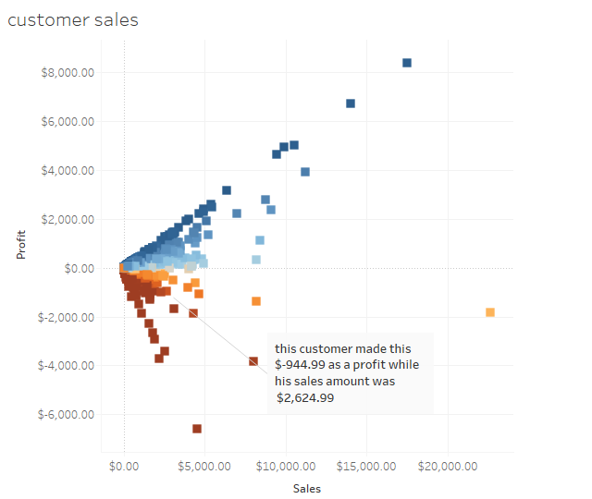
Watch this!
This vizualisation shows the clear and also weird relationship between sales and profits,stating that having high sales doesn’t guarantee good profits.

Slide 3
As a result of the data I received it seems like we have these factors that may affect sales and profit:
Geography
Discounts
Categories and sub-categories
Now let’s head to see which one seems to affect our results

Slide 4
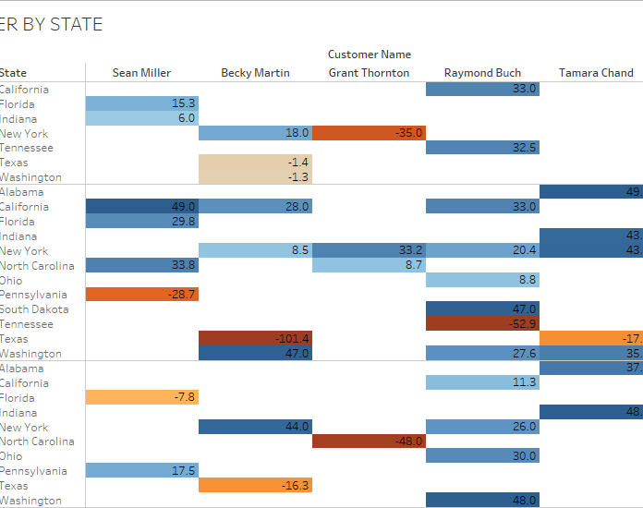
No it’s not Geography !
As shown in this image it seems that states in the US don’t really play an important rule in increasing or decreasing profit
You may wonder that there’s an extreme loss in Texas , north California and Florida.
But after testing hypothesis these are just outliers.

Slide 5
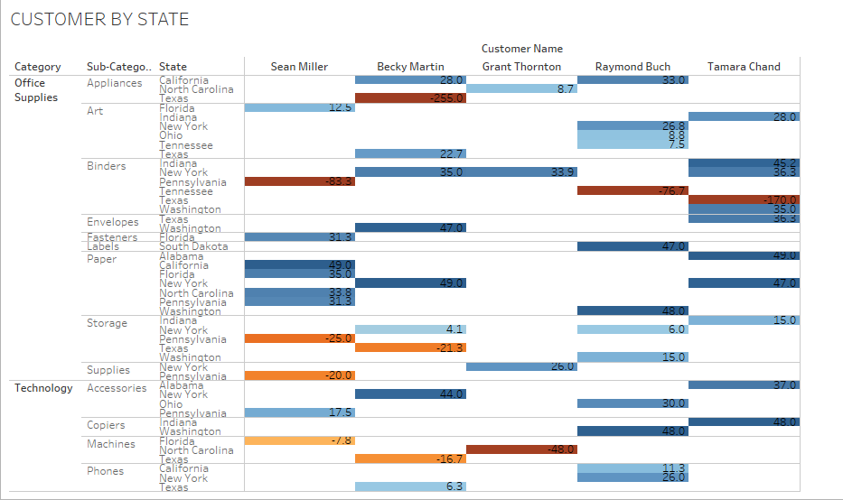
But indeed it’s the type of the product in the category that does have an impact on profit
You can check out the technology category, machines and copiers They are in the same category, yet machines seems to have large losses when comparing it to copiers
Also storage and supplies seems to be a loss in Pennsylvania .

Slide 6
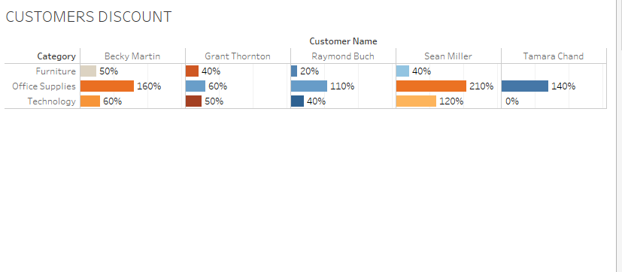
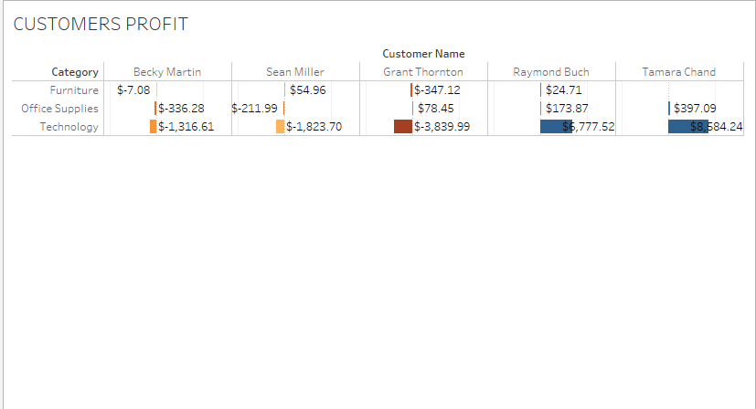
Lastly in the following slides we’ll notice the effect discounts apply on profits in different categories , I picked random 5 customers to ensure that hypothesis is true.
Here’s the customers discounts
Take a look at the same customers profit
Notes:
extremely high discounts actually do effect profit values , The more the discount the more likely it is to affect profit ratios

Slide 7
Actions and my reccomendations to improve profit:
Reduce the number of high discounts you offer. As you have concluded, high discounts can negatively impact your profitability. Instead, focus on offering targeted discounts to specific customers or groups of customers. This will help you to maximize the value of your discounts while minimizing the impact on your bottom line.
Investigate why machines are having larger losses than copiers. This could be due to a number of factors, such as the cost of the machines, the demand for machines, or the pricing strategy for machines. Once you have identified the cause of the losses, you can take steps to address it. For example, you may need to increase the prices of machines, offer more discounts on machines, or find ways to reduce the cost of machines.
Improve the profitability of storage and supplies in Pennsylvania. This could involve conducting market research to understand the demand for storage and supplies in Pennsylvania, adjusting your pricing strategy, or improving your marketing efforts in Pennsylvania.
Reduce your operating costs. As much as the discounts may seem the problem , trying to Reduce operating costs is very effective.There are a number of ways to reduce your operating costs, such as negotiating better deals with suppliers, streamlining your shipping process, and automating your marketing campaigns.

